Slide 1
EFFECTIVE COMMUNICATION
ADV JYOTI JHA

Slide 2




Slide 3

What is Effective Communication?
Effective communication is the process of exchanging ideas, thoughts, opinions, knowledge, and data so that the message is received and understood with clarity and purpose and purity of the communication should be retained.

Slide 4

P Purity
P Purpose
C Clarity

Slide 5
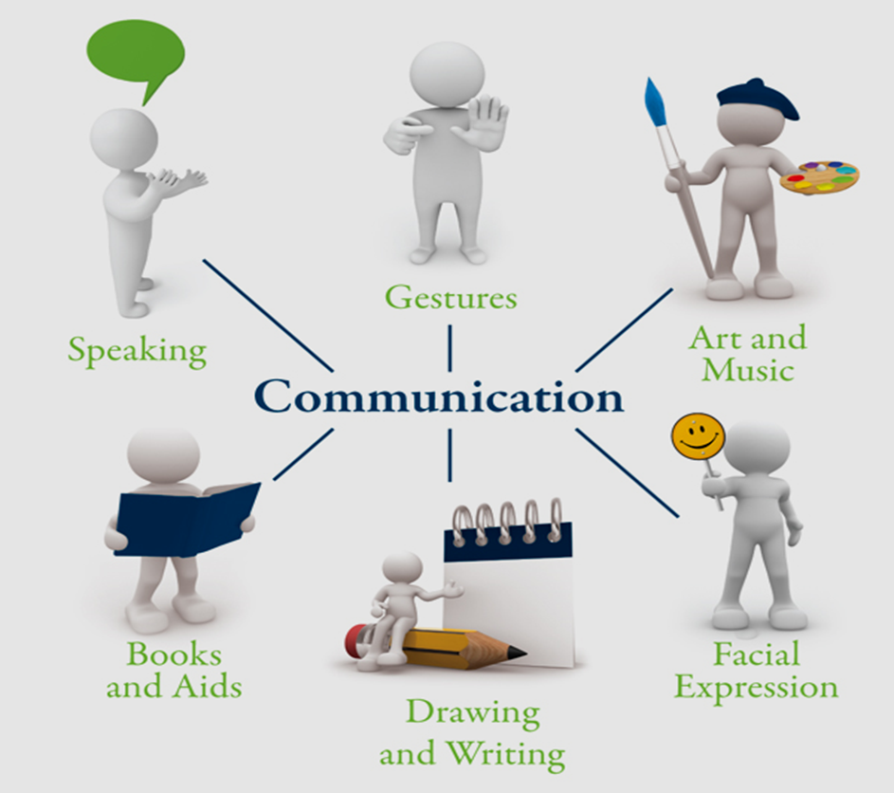

Slide 6
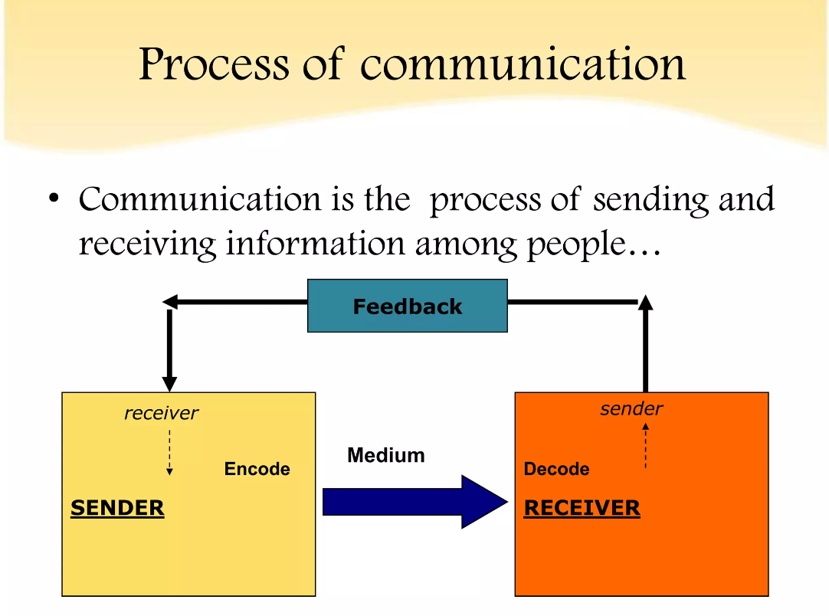

Slide 7
Barriers of Communication

Slide 8
Semantic Barrier
Language
Badly expressed message
Faulty translation
Symbol with different meaning

Slide 9
Psychological Barrier
Selective Listening
Premature Evaluation
Inattention
Poor Retention
Failure to Communicate
Distrust

Slide 10
Organizational Barrier
Rule and regulations
Policies
Authority
Hierarchy

Slide 11
Personal Barrier
Lack of ability
Lack of confidence
Ignoring communication
Lack of time

Slide 12
Emotional Barrier
When feeling angry
When pride is getting in the way
When you are feeling anxious
When apathy shuts down emotions

Slide 13
The Levels of Communication
Extra personal
Intra personal
Inter personal
Organizational
Mass Communication

Slide 14
STEPS FOR MAKING COMMUNICATION EFFECTIVE

Slide 15

CATPAW

Slide 16
Clarity of Ideas
Ability to understand Emotions (Empathy)
Two-way Communication

Slide 17
Purpose of Communication
Appropriate Language
Words with Action

Slide 18
7C’s of Communication
7C’s
Clear
Concise
Concrete
Courteous
Correct
Coherent
Complete

Slide 19
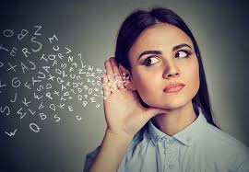
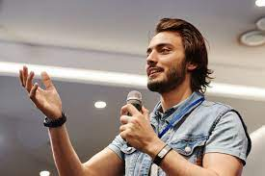
Communication

Slide 20
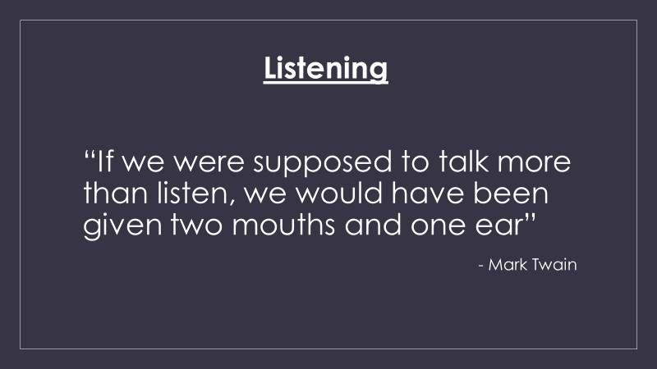

Slide 21
Hearing VS Listening

Slide 22
Hearing
Listening
Understanding not required
Effortless
Process of perceiving sound
Includes perceiving multiple sounds at a time
Ex: Music in the background
Does require effort to understand
Effort, Concentration and Focus
Process of understanding and responding
Includes perceiving one sound at a time
Ex: Gaining Information

Slide 23
The LUTRe Way of Listening

Slide 24
Listen
Understand
Think
Respond

Slide 25
Researches Say,
“If we don’t listen attentively, we are able to remember only 25% of the content.”

Slide 26
Techniques of Effective Listening
Be open-minded
Put the speaker at ease
Understand the topic well

Slide 27
Listening Approach

Slide 28

1. Critical Listening
(Understanding, Evaluating, Judging & forming an opinion)

Slide 29
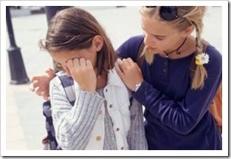
2. Empathic Listening
(Being attentive and responsive to others)

Slide 30

3. Reductive Listening
(Result Oriented)

Slide 31

4. Expansive Listening
(Includes a large area)

Slide 32

5. Passive Listening
(Hearing someone or something without putting 100% of your attention)

Slide 33

6. Active Listening
(Attention, Respond and Reflect)

Slide 34
Interaction

Slide 35
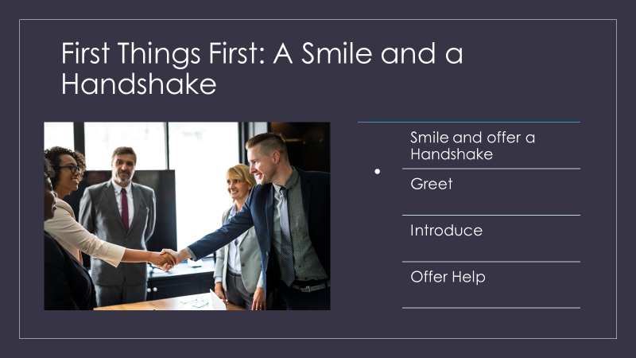

Slide 36
Role of Body Language in Communication

Slide 37
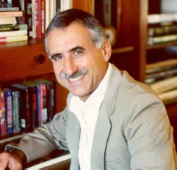
"7-38-55 Rule" (1981)
Body Language Expert Prof. Albert
Mehrabian of the University of
California in Los Angeles

Slide 38
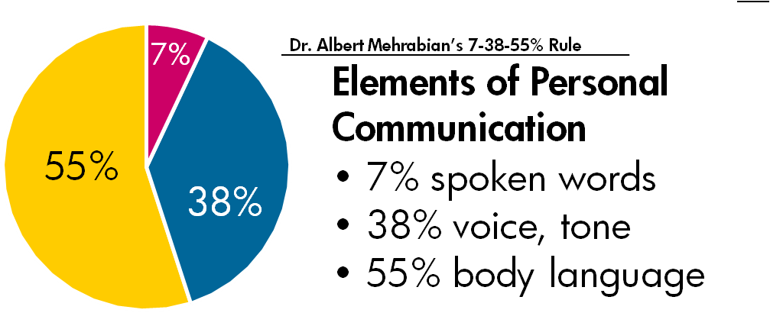
Importance of Body Language

Slide 39
Researches Say,
10% of conflicts are due to difference in opinion, 90% due to delivery, tone, voice and wrong selection of words.

Slide 40


Slide 41
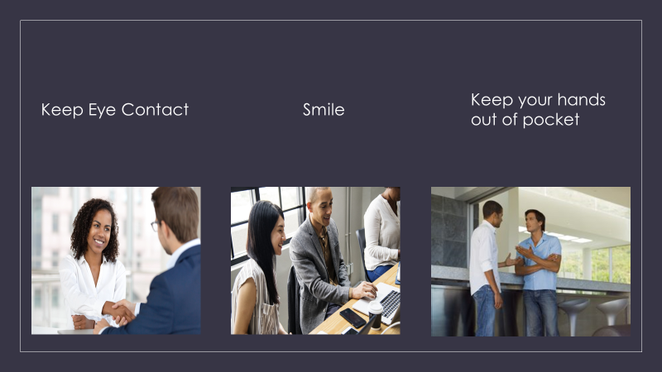

Slide 42


Slide 43
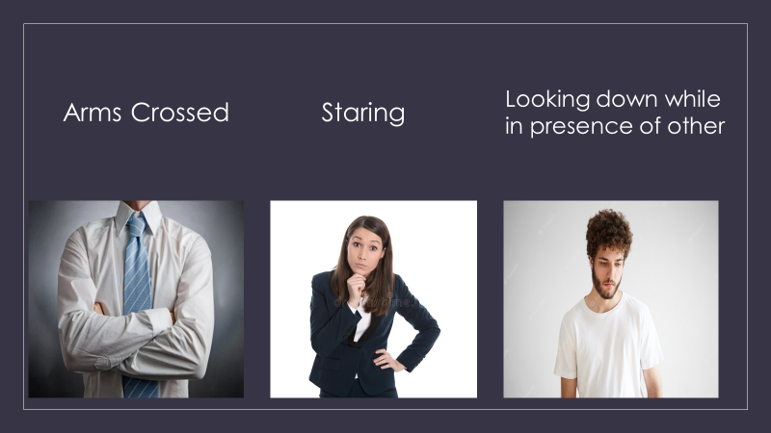

Slide 44
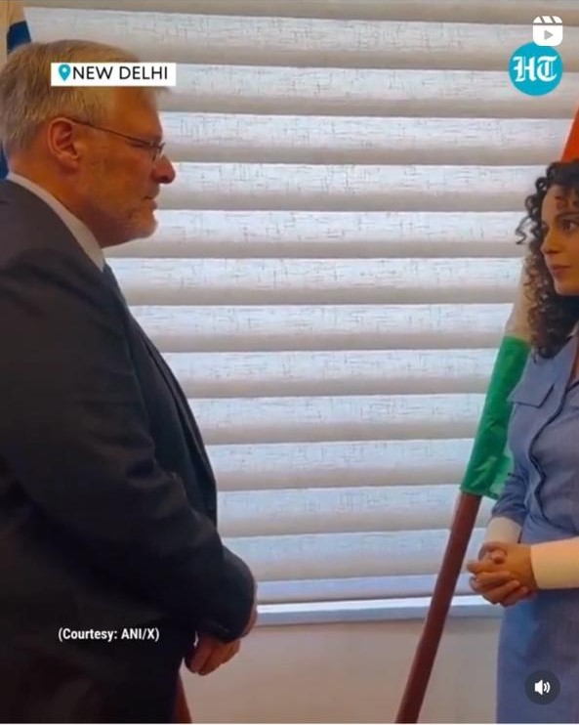
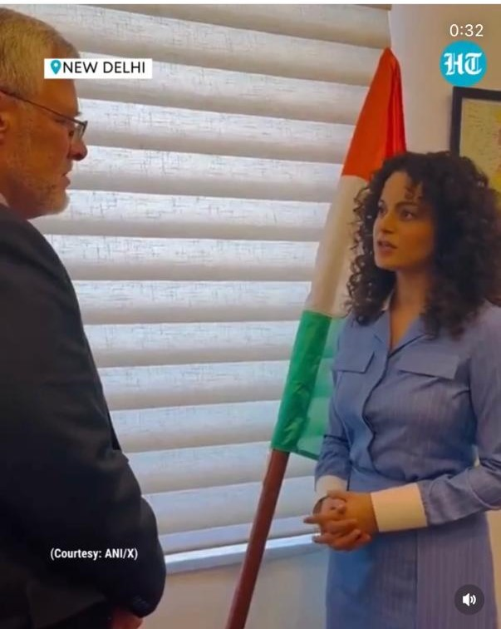
Appropriate Body Language
Naor Gilion
Kangana Ranaut

Slide 45

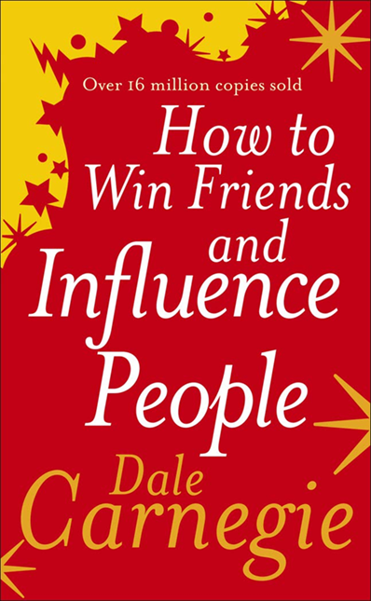
BOOKS RECOMMENDATION
Hector Garcia and Francesc Miralles
Dale Carnegie

Slide 46

Thank You!
Any Questions?

